Slide 1
An antidepressant that extends lifespan in
C. elegans
Robert Han and Alyssa Peeples

Slide 2
Question
Previous work: Some drugs were found to increase the longevity of C. elegans by inducing dietary restriction.
Paper: What drugs will do this and by what mechanism?

Slide 3
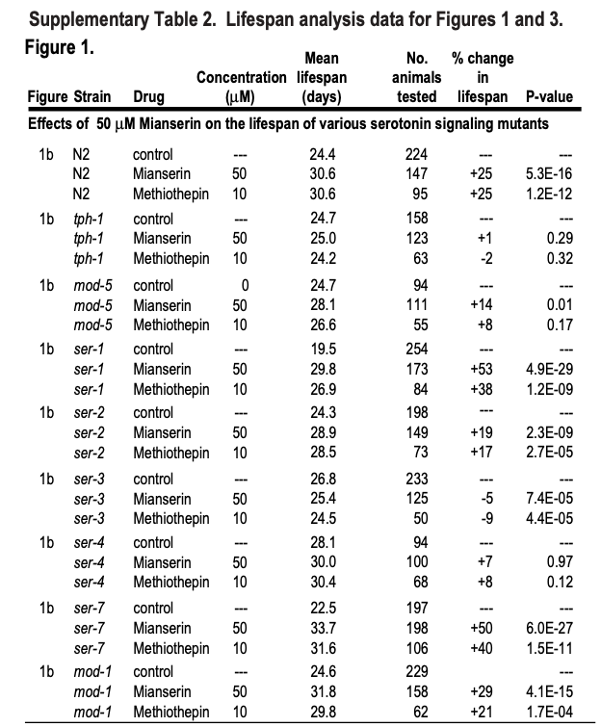
Data
Data was not available. Summary statistics were available.
Supplementary data looks like this ->

Slide 4
Experiment
Which drugs increase longevity?
Drug worms -> measure longevity
What mechanism do these drugs work by?
Drug strains of worms with mutations in suspected pathways -> measure longevity
Explore molecular interactions to verify (drug-receptor)

Slide 5
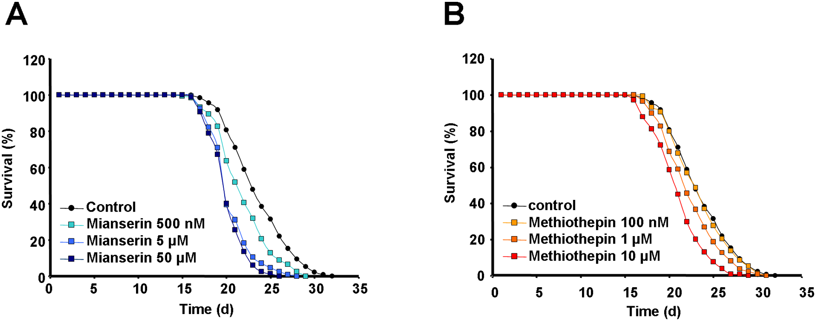
Problems
Follow-up studies could not reproduce findings (Zarse and Ristow 2008)
Raw data is missing
Follow up study shows opposite effect (Zarse and Ristow 2008)

Slide 6
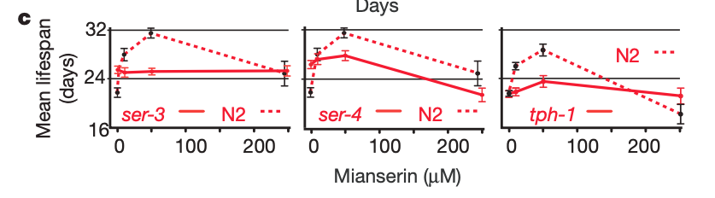
Replicating
We believe given a dataset we can replicate the analysis done using R
Figure 1.c Mean lifespan as a function of Mianserin concentration in C.elegans mutants with mutations in the serotonin and octopamine pathways. (Petrascheck, Ye, and Buck 2007)

Slide 7
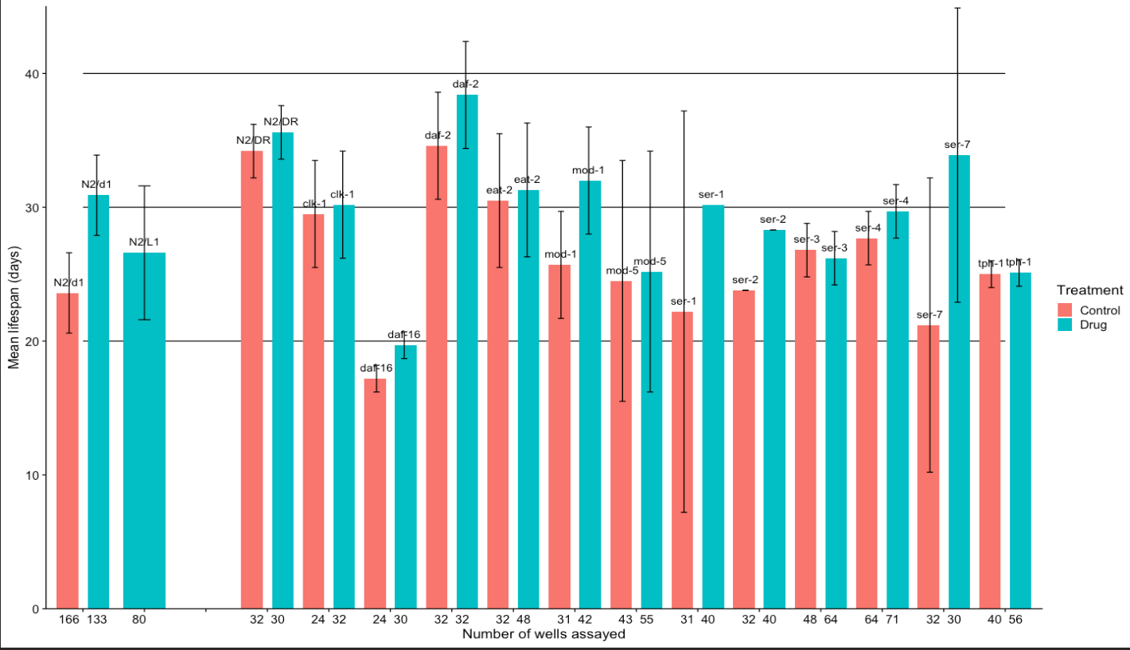
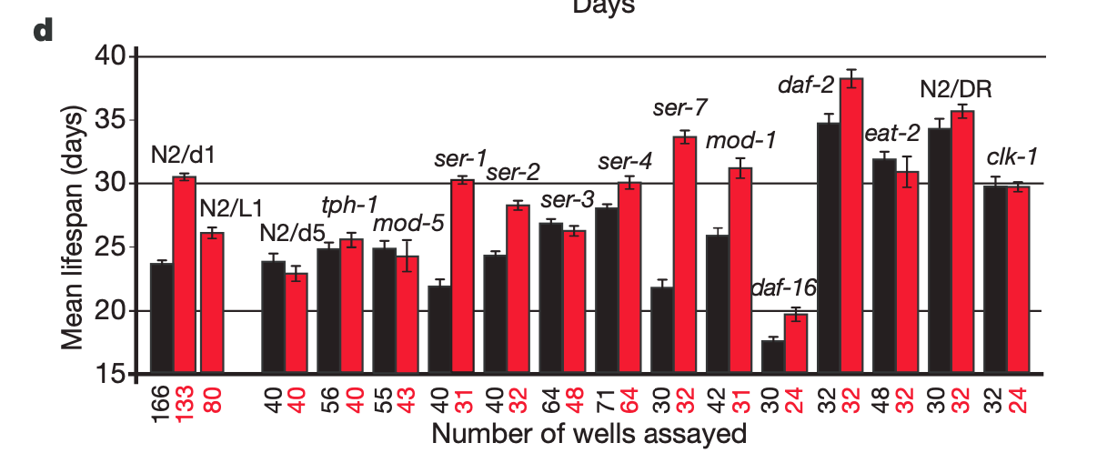
Our recreation (Homework 4)
From the paper (Homework 4)

Slide 8
QRP
Lack of data (Possible cherry-picking or p-hacking)
“Censored data” (not really censored)
Data exclusion (Possible cherry-picking)
No mention of Bonferroni correction

Slide 9
Pre-registration

